Slide 1
A “New-Old” Approach to Collaboration: Havruta-Style Text Study
Ashley Lucas & Rebecca Shargel
Towson University

Slide 2
What is Havruta-Style Text Study
What is it:
Conversational style of text study
Used for studying complex texts in foreign languages
Rooted in Jewish academies
Recently, educators experimenting in secular contexts, such as university classes.
Partners:
Read text aloud to each other
Dive into language
Engage in deep discussion
Work out meanings
Deepen comprehension through a collaborative dialogue
Grow intellectually and interpersonally
Text as Partner
Havruta Partner
Havruta Partner

Slide 3
Havruta-Style Text Study
Slow down and do a deep dive into the meaning of the text with a partner.
Listening & Articulating
Supporting and Challenging (Holzer & Kent, 2014)
We emphasized:
1. Reading aloud (take turns)
2. Define vocabulary as they come up
3. Put text in your own words (paraphrase).
4. Listen to text. What is the author saying?
5. Agree/ disagree with your partner.
6. Provide guiding questions

Slide 4
What does it look like?
You are in groups of 2 or 3 and are given a chunked text that is followed by questions
Read text aloud to partner (text can be divided line-by-line, paragraph-by-paragraph depending on the text).
You reread the section and paraphrase the text.
You discuss, deliberate, question meaning (Examine new vocabulary).
You continue with the rest of the text until they complete the reading.

Slide 5
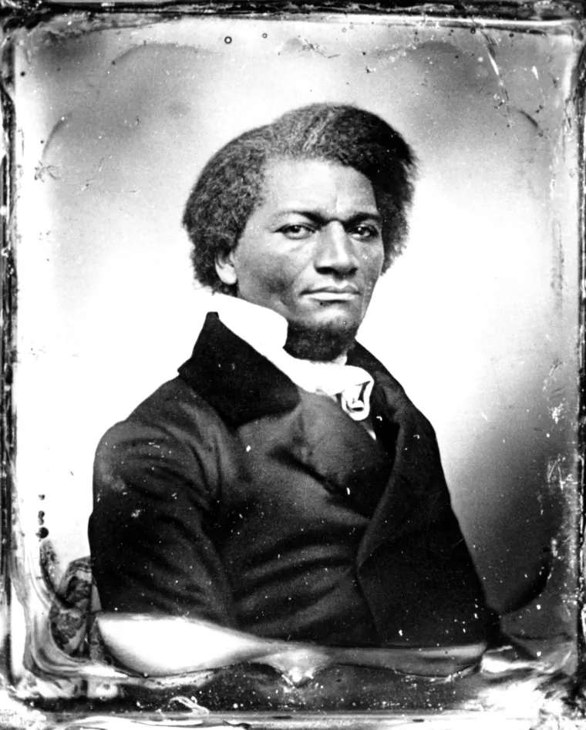
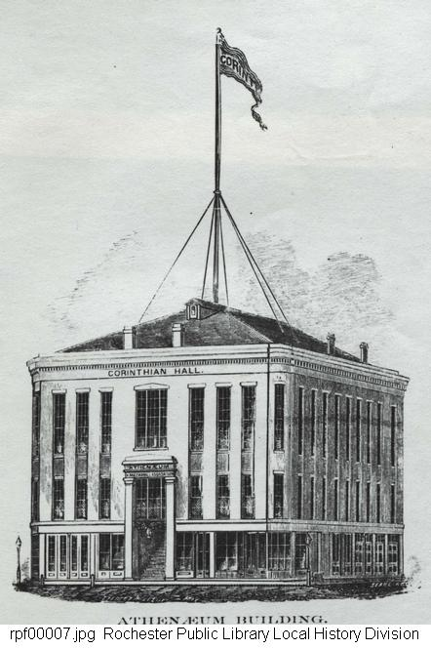
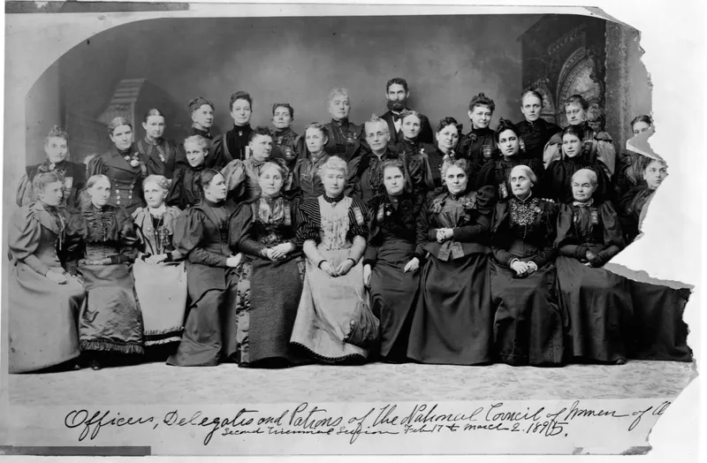
What to The Slave is The Fourth of July?
Asked to give a keynote address at an Independence Day celebration in Rochester, New York in 1852 to the Rochester’s Ladies Anti-Slavery Society.

Slide 6
What to a Slave is the Fourth of July?
Frederick Douglass, July 5, 1852 (abridged)
The fact is, ladies and gentlemen, the distance between this platform and the slave plantation, from which I escaped, is considerable—and the difficulties to be overcome in getting from the latter to the former, are by no means slight. That I am here today is, to me, a matter of astonishment as well as of gratitude.
STOP HERE:
This, for the purpose of this celebration, is the 5th of July. It is the birthday of your National independence, and of your political freedom...There is consolation in the thought that America is young. Great streams are not easily turned from channels, worn deep in the course of ages. They may sometimes rise in quiet and stately majesty, and inundate the land, refreshing and fertilizing the earth with their mysterious properties. They may also rise in wrath and fury, and bear away, on their angry waves, the accumulated wealth of years of toll and hardship.
STOP HERE:
They however, gradually flow back to the same old channel, and flow on as serenely as ever. But, while the river may not be turned aside, it may dry up, and leave nothing behind but the withered branch, and the unsightly rock, to howl in the abyss-sweeping wind, the sad tale of the departed glory. As with rivers so with nations.
STOP HERE:

Slide 7
An Invitation​
We come to this from a teaching point of view. Would you want to apply thisto your classroom and any educational context– grades 3 and up (anydiscipline and any type of learner).​
For all professions: Do you collaborate? Could you see this method adaptedto your work?​
Do you face difficult texts as part of your work?​
Would you like to collaborate with us and try it out?​

